Slide 2
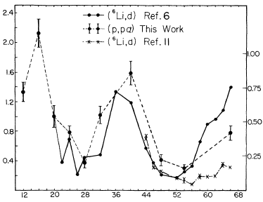
Cluster knockout reactions
S_{α} : transfer vs (p,pα)
Well-studied with proton beams
on stable targets
Extraction of S_{α}
Incident energy : 100~ MeV/u
One-step direct reaction
Surface-peaked reaction
S_{α} (relative)
S_{α} (absolute)
(T. Carey et al., PRC (1984))
Target mass No.
p
p
α
α
Notes:
Sa provides a measure of clustering

Slide 3
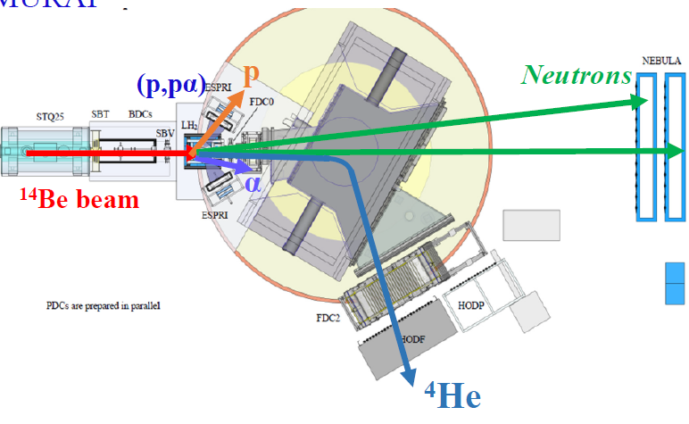
Study ^{10,12, 14}Be(p,pα) at 150 MeV/u
Clustering in n-rich Be
First spectrum for the 6n system
Missing-mass measurement
measure: GS → GS and GS → 2⁺ transitions
^{10,12,14}Be beams
150 MeV/u
Solid H target
2mm
Ph.D student: Pengjie LI (HKU)
Collaboration: IJCLab, Hong Kong U., RIKEN, TI Tech, LPC Caen, Tohoku U., RCNP Osaka,
CEA Saclay, Kyoto U., TU Darmstadt, NIPNE Bucharest, Kyushu U.
Notes:
- Neutron: 2 layers to characterize the 2-neutron emission from populated states in nuclear systems

Slide 4
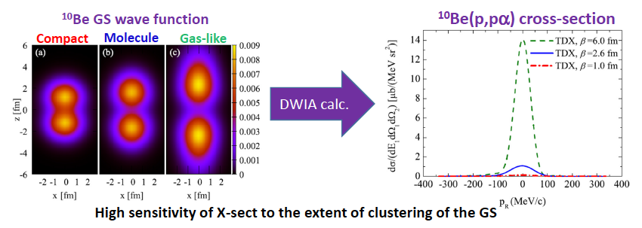
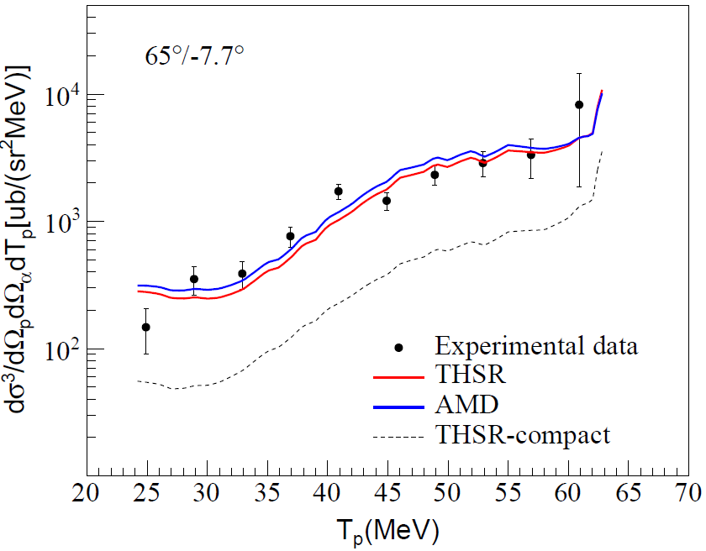
Probing cluster structures using knockout reactions
The high sensitivity of the cluster KO X-Section to the
extension of the ¹⁰Be “molecule” was established
theoretically (M.Lyu et al., PRC 97 (2018) )
All Norm. Fact. = 1.
Present Study @ RIKEN :
First measurement of TDX in IK (RIB)
Kinematics include recoiless condition
(quasifree scattering)
Analysis : DWIA Calc. within a microscopic framework
THSR cluster WF
AMD (mean field) WF
Both predict a 2alpha + 2 neutron in π “ring” orbit
with moderate alpha-extension
Compact
(SM-like) ¹⁰Be
Interpretation of ^{12,14}Be(p,pα) results ongoing
Direct evidence of the molecular structure of ¹⁰Be

Slide 5
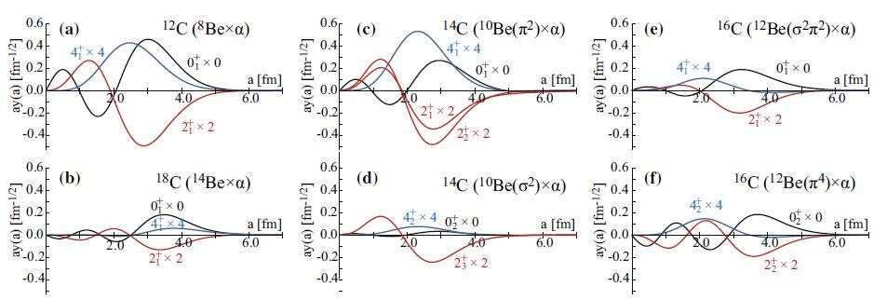
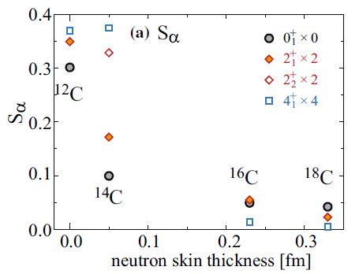
Clustering and neutron skin in C isotopes
Q. Zhao, Y. Suzuki, J. He, B. Zhou, M. Kimura, EPJA 157 (2021)
AMD calculations using Gogny D1S functional
RWA
Alternative interpretations
Neutron single-particle configurations
Relationship between α-clustering and
α-threshold
Notes:
Do not consider plot d) and f) (transition to excited states)
Thus, alpha clustering suppression by the growth of neutron-skin likely exists for light mass isotope chain
However one can invoke
- Neutron sp config configuration strongly influence the n-skin and Be core structuree

Slide 6
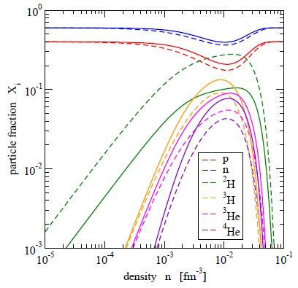
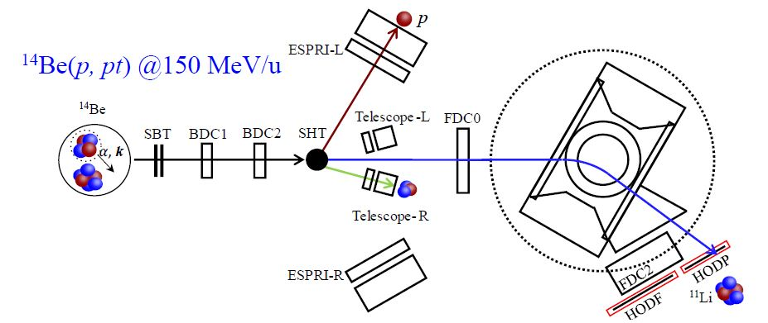
Probing new clustering using knockout and transfer reactions
All kind of clusters should be formed
At low density
We investigated triton formation at the surface of neutron-rich light nuclei
using the surface-peaked ¹⁴Be(p,pt)¹¹Li reaction at RIKEN
S.Typel, J.Phys.Conf.Ser.420,012078(2013)
ONOKORO project at RIKEN & RCNP
(T.Uesaka, J.Zenihiro)
Medium-mass nuclei
TOGAXSI detector

Slide 7
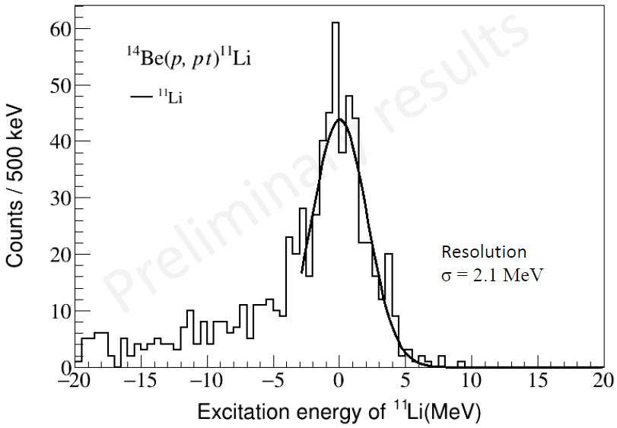
Probing new clustering using knockout and transfer reactions
All kind of clusters should be formed
At low density
We investigated triton formation at the surface of neutron-rich light nuclei
using the surface-peaked ¹⁴Be(p,pt)¹¹Li reaction at RIKEN
S.Typel, J.Phys.Conf.Ser.420,012078(2013)
At GANIL
Triton at the surface of light n-rich nuclei
could be investigated using (p,alpha)
no RIKEN data for ^{10,12}Be(p,pt)
MUGAST proposal under elaboration
(V.Alcindor, D.B. et al,….)
Preliminary
A sizeable count-rate
is observed !
Still under analysis

Slide 8
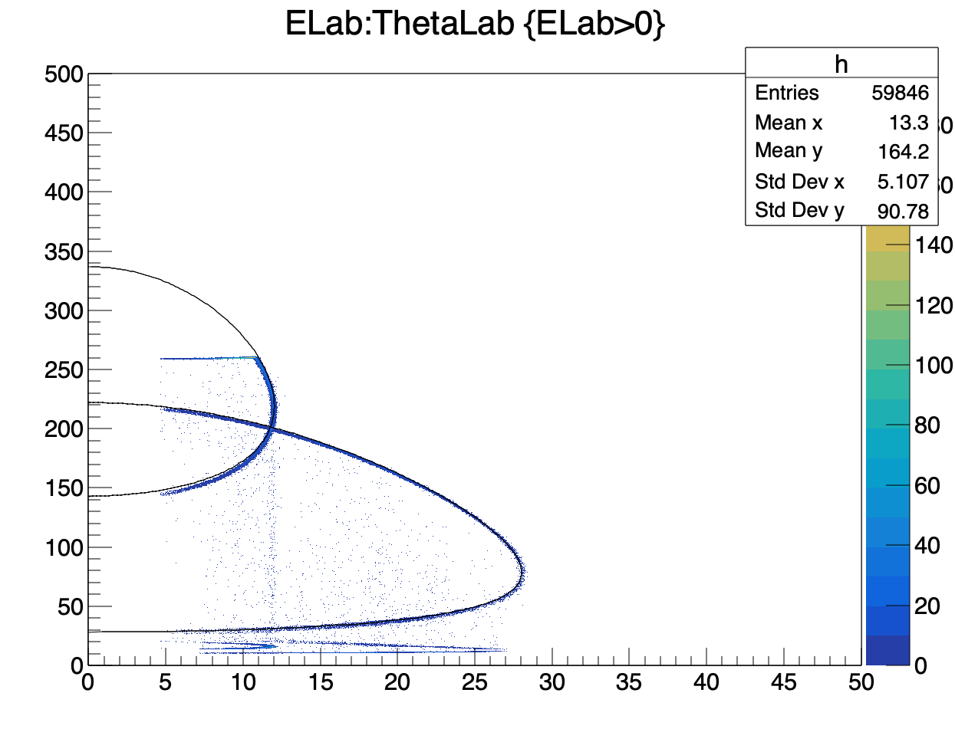
Possible study at LISE with MUGAST-EXOGAM
^{10,11,12}Be(p,α) triton pickup
Residues : ^{7,8,9}Li
Simulations and count-rate
estimates undergoing
⁹Li
alpha

